Slide 1
Bellwork
Grab a textbook
The number of nuclear power plants in the top 15 nuclear power-producing countries in the world are listed. Using a calculator, find the mean, variance, and standard deviation of the data set below.
7, 18, 11, 6, 59, 17, 18, 54, 104, 20, 31, 8, 10, 15, 19

Slide 2
2.5 Measures of Position
LEQ 1: What measure of central tendency is used to create quartiles?
LEQ 2: How is the IQR utilized to identify outliers?
LEQ 3: What does a z-score measure and what is considered to be a usual range?

Slide 3
Quartiles
What do you think the quartiles might be?
Quartile 1: 25% of the data falls under
Quartile 2: 50% of the data falls under (and above)
Quartile 3: 75% of the data falls under
How do you think you will find the Quartiles?

Slide 4
Finding Quartiles (odd number of entries)
The number of nuclear power plants in the top 15 nuclear power-producing countries in the world are listed. Find the first, second, and third quartiles of the data set. What can you conclude? 7, 18, 11, 6, 59, 17, 18, 54, 104, 20, 31, 8, 10, 15, 19
Begin by finding the median (Q2). Remember to reorganize.
The median splits the data in two.
Find the medians of the lower half (Q1) and the upper half (Q3)
Minimum: 6, Maximum: 104

Slide 5
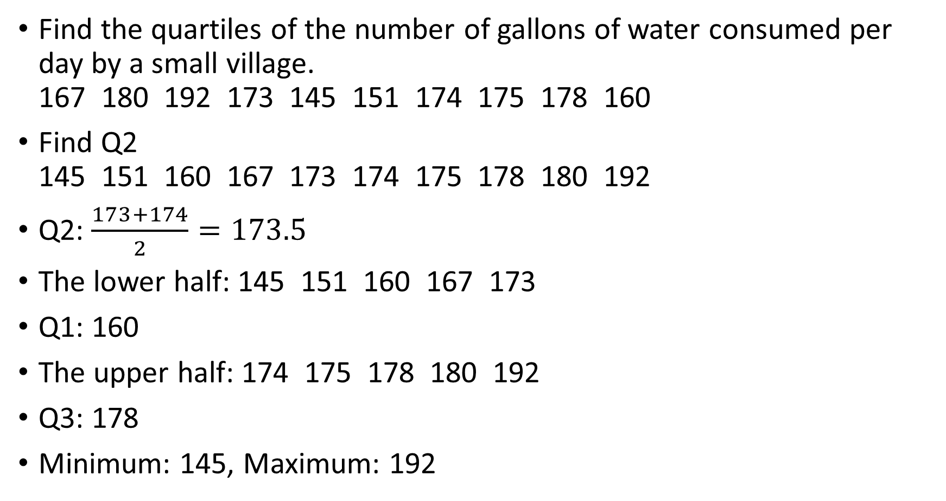
Finding Quartiles (even number of entries)
Find the quartiles of the number of gallons of water consumed per day by a small village. 167 180 192 173 145 151 174 175 178 160
Find Q2 145 151 160 167 173 174 175 178 180 192
Q2: $\frac{173+174}{2}=173.5$
The lower half: 145 151 160 167 173
Q1: 160
The upper half: 174 175 178 180 192
Q3: 178
Minimum: 145, Maximum: 192

Slide 6
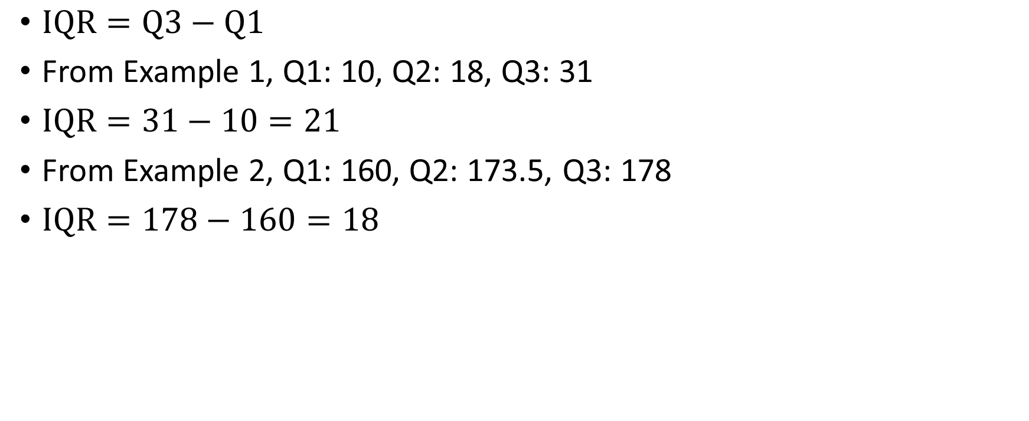
Interquartile Range (IQR)
$IQR=Q3−Q1$
From Example 1, Q1: 10, Q2: 18, Q3: 31
$IQR=31−10=21$
From Example 2, Q1: 160, Q2: 173.5, Q3: 178
$IQR=178−160=18$

Slide 7
The Five-Number Summary
Minimum Entry
Q1
Median (Q2)
Q3
Maximum Entry
We can use this five number summary to eliminate the guess work on identifying outliers.
This can all be found with the calculator with in the same manner as we found standard deviation. Just scroll down.

Slide 8
Try it on your own
On page 108 try numbers 21 and 22 (only part a of the directions) also find the IQR
21) Min: 24, Q1: 28, Median: 35, Q3: 41, Max: 60 $$IQR=41−28=13$$
22) Min: 150, Q1: 172, Median: 177, Q3: 180, Max: 182 $$IQR=180−172=8$$

Slide 9
Identifying Outliers
$Q3+1.5\left(IQR\right)$ is the cut off for outliers to the right (or above)
$Q1−1.5(IQR)$ is the cut off for outliers to the left (or below)
Example 1 Five-number Summary:
6
10
18
31
104
Upper cut off: $31+1.5\left(21\right)=31+31.5=62.5$
Lower cut off: $10−1.5\left(21\right)=10−31.5=−21.5$
So, 104 is an outlier

Slide 10
Drawing a Box Plot (a.k.a Box and Whiskers Plot)
Simply plot the five number summary on a number line.
Q1, Q2 (Median), and Q3 get a box
Draw a line from Q1 to the minimum
Draw a line from Q3 to the maximum

Slide 11
Drawing a Box Plot
Draw a Box Plot for Example 1.
Five-number Summary:
6
10
18
31
104

Slide 12
Try it on your own
Draw the box plots from numbers 21 and 22

Slide 13
A Living Box Plot
How much sleep did you get last night?
Write down how much sleep you had last night on the board.
Find the 5 number summary of the class’s amount of sleep and determine if there are any outliers.
Come up to the board and stand on the number line on the whiteboard that corresponds to how much sleep you had.
Now, the median value, 1st quartile, and 3rd quartile step forward.
Any outliers turn toward the wall closest to you.

Slide 14
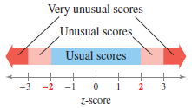
Z-Scores (Standardizing Values)
Z-scores standardize values so that we can compare results from two different data sets with different scales or units.
Z-scores tell us how many standard deviations a value is from the mean.
$z=\frac{\left(x−μ\right)}{σ}$

Slide 15
Finding and Interpreting z-scores
The mean speed of vehicles along a stretch of highway is 56 miles per hour with a standard deviation of 4 miles per hour. You measure the speeds of three cars traveling along this stretch of highway as 62 miles per hour, 47 miles per hour, and 56 miles per hour. Find the z-score that corresponds to each speed. What can you conclude?
$z_{1}=\frac{62−56}{4}=1.5$
$z_{2}=\frac{47−56}{4}=−2.25$
$z_{3}=\frac{56−56}{4}=0$

Slide 16
Try it on your own
In 2009, Heath Ledger won the Oscar for Best Supporting Actor at age 29 for his role in the movie The Dark Knight. Penelope Cruz won the Oscar for Best Supporting Actress at age 34 for her role in Vicky Cristina Barcelona. The mean age of all Best Supporting Actor winners is 49.5, with a standard deviation of 13.8.The mean age of all Best Supporting Actress winners is 39.9, with a standard deviation of 14.0. Find the z-scores that correspond to the ages of Ledger and Cruz. Then compare your results.
$z_{H}=\frac{29−49.5}{13.8}=−1.49$
$z_{P}=\frac{34−39.9}{14}=−0.42$
Which performance was comparatively more impressive?
Is either performance unusual?
Why is Heath Ledger’s performance still within the usual range despite being so far away from the mean?

Slide 17
Practice Problems
Pg. 107 #5, 12 – 17, 23, 39 – 41, 43

