Slide 1
Module 3: Probability Rules
We will finish the test today. You will have 15 minutes.
Get out your vocabulary assignment from yesterday so I can check it off.

Slide 2
3.1: Basic Concepts of Probability and Counting

Slide 3
Definitions to know
Probability experiment is an action, or trial, through which specific results (counts, measurements, or responses) are obtained.
Outcome is the result of a single trial in a probability experiment.
Sample space is the set of all possible outcomes of a probability experiment.
Event is a subset of the sample space. It may consist of one or more outcomes
Simple event is an event that consists of a single outcome.
Range of Probabilities: The probability of an event E is between 0 and 1, inclusive. That is, $0≤P(E)≤1$. See pg. 135 for usual/likely percentages
What does it meant to have a probability of 0? What about 1?

Slide 4
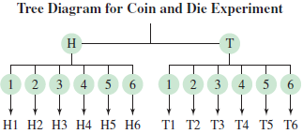
Identifying the Sample Space of a Probability Experiment
A probability experiment consists of tossing a coin and then rolling a six-sided die. Determine the number of outcomes and identify the sample space.
How many different outcomes are there?
We could create a tree diagram to help visualize this.
The sample space would be: {H1, H2, H3, H4, H5, H6, T1, T2, T3, T4, T5, T6}

Slide 5
Identifying Simple Events
Determine the number of outcomes in each event. Then decide whether each event is simple or not. Explain your reasoning.
You roll a six-sided die. Event B is rolling at least a 4.
Answer: You could roll a 4, 5, or 6, so there are three outcomes, so it is not a simple event.
Event C:The student’s age is between 18 and 23, inclusive.
Answer: Age could be 18, 19, 20, 21, 22, or 23, so it is not a simple event.
Event D:The student’s age is 20.
Answer: Age could only be 20, so it is a simple event.

Slide 6
The Fundamental Counting Principle
If one event can occur in m ways and a second event can occur in n ways, the number of ways the two events can occur in sequence is $m∙n$. This rule can be extended to any number of events occurring in sequence.
Example: You are purchasing a new car. The possible manufacturers, car sizes, and colors are listed.
Manufacturer: Ford, GM, Honda
Car size: compact, midsize
Color: white (W), red (R), black (B), green (G)
How many different ways can you select one manufacturer, one car size, and one color?
Answer: $3∙2∙4=24$ possible different outcomes.

Slide 7
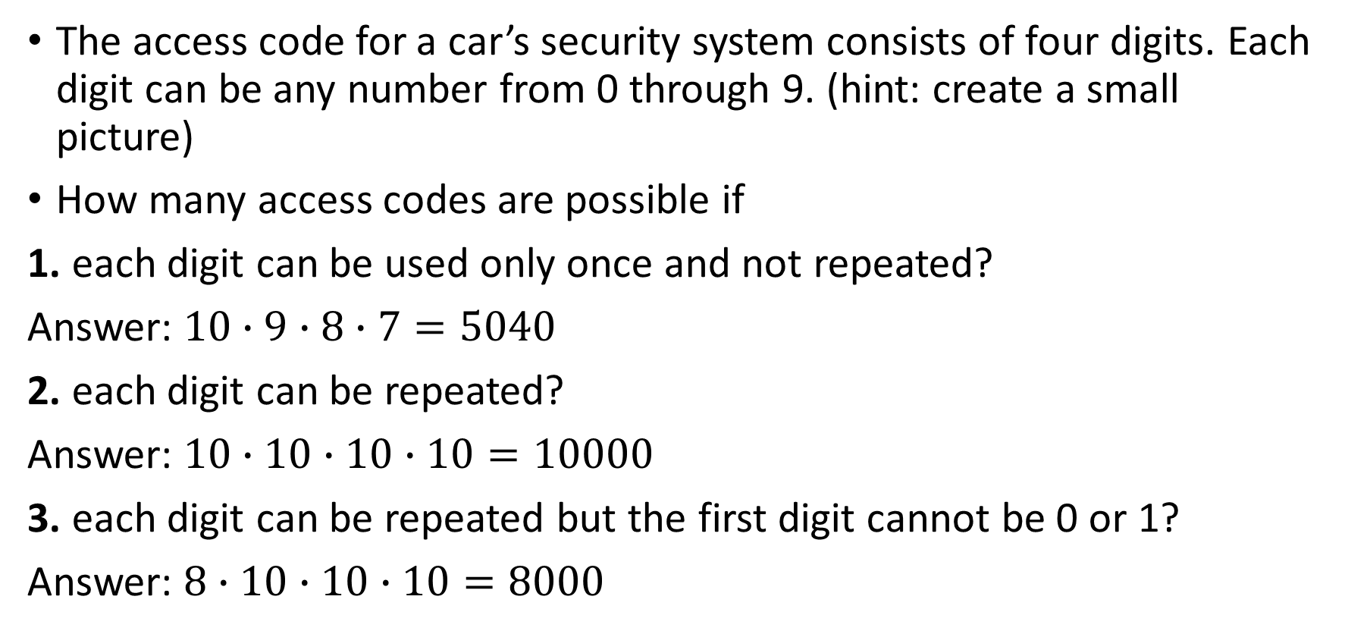
Using the Fundamental Counting Principle
The access code for a car’s security system consists of four digits. Each digit can be any number from 0 through 9. (hint: create a small picture)
How many access codes are possible if
1. each digit can be used only once and not repeated?
Answer: $10∙9∙8∙7=5040$
2. each digit can be repeated?
Answer: $10∙10∙10∙10=10000$
3. each digit can be repeated but the first digit cannot be 0 or 1?
Answer: $8∙10∙10∙10=8000$

Slide 8
Using the Fundamental Counting Principle
Your debit card pin number is four digits long and each number can contain any digit from 0 to 9. What is the probability of getting your pin number when randomly generating a four digit number?
How many outcomes are in the event?
Answer: 1
How many outcomes are in the sample space?
Answer: $10∙10∙10∙10=10000$
What is the probability?
Answer: $\frac{1}{10000}=.0001$

Slide 9

Classical (or theoretical) probability
Used when each outcome in a sample space is equally likely to occur. The classical probability for an event E is given by
$$P\left(E\right)=\frac{Number of outcomes in an event}{Total number of outcomes in the sample space}$$

Slide 10
Finding Classical Probabilities
You roll a six-sided die. Find the probability of each event.
1. Event A: rolling a 3
Answer: $\frac{1}{6}=.167$
2. Event B: rolling a 7
Answer: $\frac{0}{6}=0$
3. Event C: rolling a number less than 5
Answer: $\frac{4}{6}=.667$

Slide 11
Empirical (or statistical) probability
Based on observations obtained from probability experiments. The empirical probability of an event E is the relative frequency of event E.
$$P\left(E\right)=\frac{Frequency of event E}{Total frequency}=\frac{f}{n}$$

Slide 12
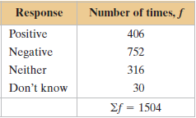
Finding Empirical Probabilities
A company is conducting a telephone survey of randomly selected individuals to get their overall impressions of the past decade (2000s). So far, 1504 people have been surveyed. The frequency distribution shows the results. What is the probability that the next person surveyed has a positive overall impression of the 2000s?
Answer: $\frac{406}{1504}=.27$

Slide 13
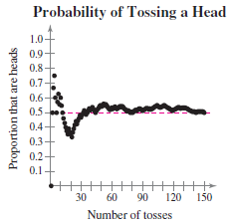
Law of Large Numbers
As an experiment is repeated over and over, the empirical probability of an event approaches the theoretical (actual) probability of the event.
Think about flipping a coin.

Slide 14
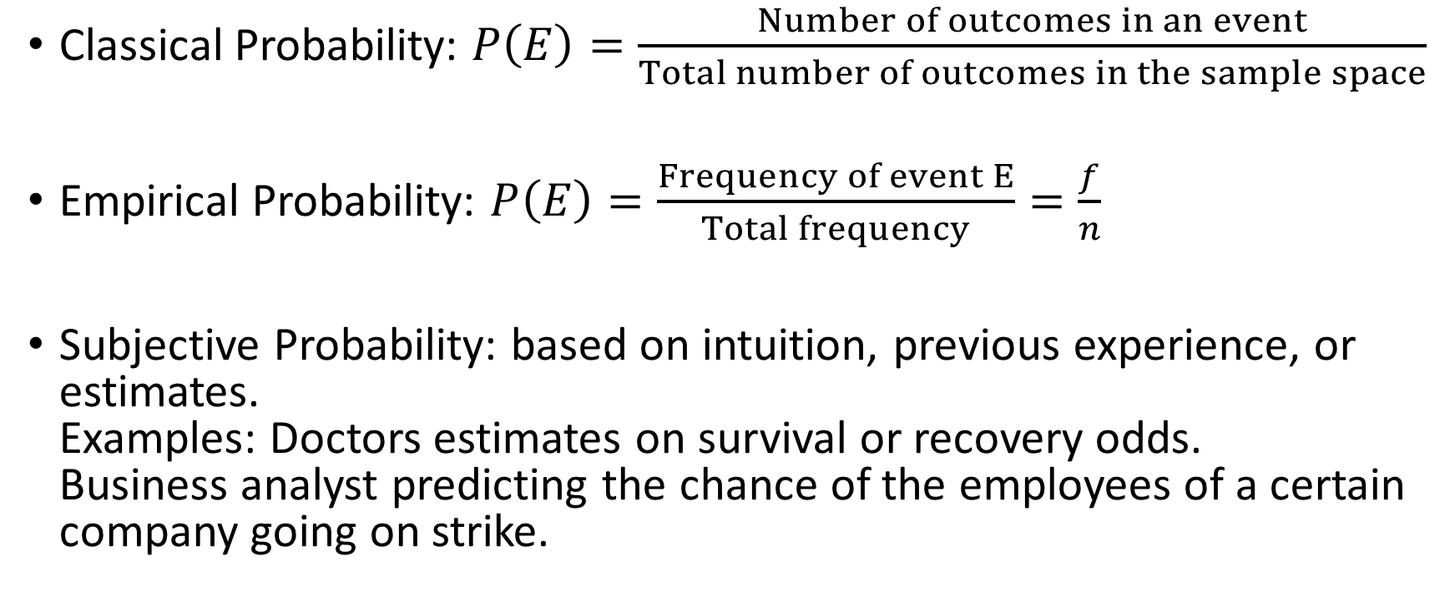
Types of probability
Classical Probability: $P\left(E\right)=\frac{Number of outcomes in an event}{Total number of outcomes in the sample space}$
Empirical Probability: $P\left(E\right)=\frac{Frequency of event E}{Total frequency}=\frac{f}{n}$
Subjective Probability: based on intuition, previous experience, or estimates. Examples: Doctors estimates on survival or recovery odds. Business analyst predicting the chance of the employees of a certain company going on strike.

Slide 15
Classifying Types of Probability
Classify each statement as an example of classical probability, empirical probability, or subjective probability. Explain your reasoning.
1. The probability that you will get the flu this year is 0.1.
Answer: Subjective
2. The probability that a voter chosen at random will be younger than 35 years old is 0.3.
Answer: Empirical
3. The probability of winning a 1000-ticket raffle with one ticket is $\frac{1}{1000}$.
Answer: Classical

Slide 16
Complementary Events
Complement of event E is the set of all outcomes in a sample space that are not included in event E. The complement of event E is denoted by and is read as “E prime.”
What is the probability of rolling a 6 sided die and getting a number greater than 4?
Answer: $\frac{2}{6}=.333$
What is the probability of not rolling a number greater than 4? What is the complement of rolling a number greater than 4?
Answer: $1−.333=.667$

Slide 17
Practice Problems
Pg. 138 #1 – 20, 22, 24, 26, 29 – 34, 44 – 46, 55, 56,

