Slide 1
3.3: The Addition Rule
Make sure you have a calculator when you sit down

Slide 2
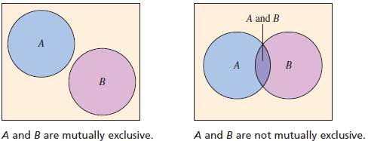
Mutually Exclusive (A.K.A. Disjoint)
Mutually exclusive: if event A and event B cannot occur at the same time.

Slide 3
Determining Mutually Exclusive Events
Decide if the events are mutually exclusive. Explain your reasoning.
Event A: Roll a 3 on a die. Event B: Roll a 4 on a die.
Answer: Mutually Exclusive
Event A: Randomly select a male student. Event B: Randomly select a nursing major.
Answer: Not Mutually Exclusive
Event A: Randomly select a blood donor with type O blood. Event B: Randomly select a female blood donor.
Answer: Not Mutually Exclusive

Slide 4
Addition Rule
The probability that events A or B will occur, $P(A or B)$, is given by
Not Mutually Exclusive: $P\left(A or B\right)=P\left(A\right)+P\left(B\right)−P(A and B)$
Mutually Exclusive: $P\left(A or B\right)=P\left(A\right)+P(B)$
If events are mutually exclusive, the addition rule can be extended to any number of events.

Slide 5
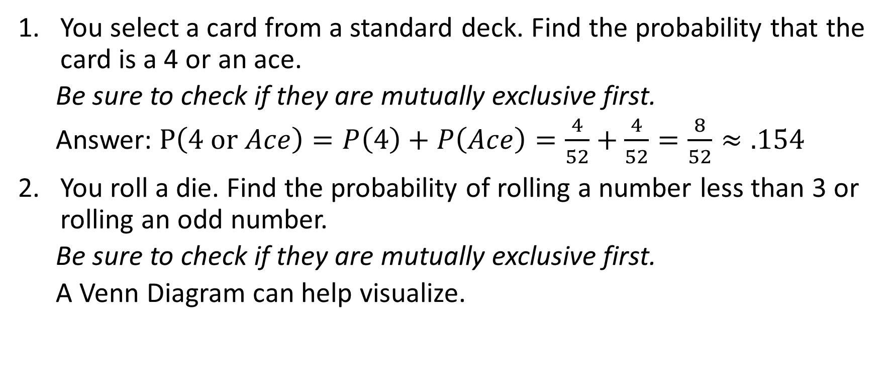
Using the Addition Rule
You select a card from a standard deck. Find the probability that the card is a 4 or an ace.
Be sure to check if they are mutually exclusive first.
Answer: $P\left(4 or Ace\right)=P\left(4\right)+P\left(Ace\right)=\frac{4}{52}+\frac{4}{52}=\frac{8}{52}≈.154$
You roll a die. Find the probability of rolling a number less than 3 or rolling an odd number.
Be sure to check if they are mutually exclusive first.
A Venn Diagram can help visualize.

Slide 6
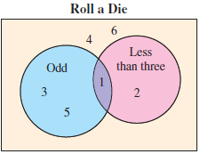
Using the Addition Rule
$P\left(less than 3 or odd\right)=P\left(less than 3\right)+P\left(odd\right)−P\left(less than 3 and odd\right)$
$P\left(less than 3\right)=\frac{2}{6}=.333$
$P\left(odd\right)=\frac{3}{6}=.5$
$P\left(less than 3 and odd\right)=\frac{1}{6}=.167$
$P\left(less than 3 or odd\right)=.333+.5−.167$
$P\left(less than 3 or odd\right)=.667$

Slide 7
Try it on your own
A die is rolled. Find the probability of rolling a 6 or an odd number.
Answer: Mutually Exclusive, $P\left(6 or odd\right)=\frac{1}{6}+\frac{3}{6}=\frac{4}{6}=.667$
A card is selected from a standard deck. Find the probability that the card is a face card or a heart.
Answer: Not mutually exclusive, $P\left(face or heart\right)=\frac{12}{52}+\frac{13}{52}−\frac{3}{52}=\frac{22}{52}=.423$

Slide 8
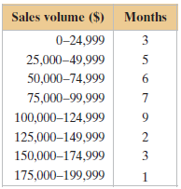
Using the Addition Rule
The frequency distribution shows volumes of sales (in dollars) and the number of months in which a sales representative reached each sales level during the past three years. If this sales pattern continues, what is the probability that the sales representative will sell between $75,000 and $124,999 next month?
Next month’s numbers will be either between 75,000 and 99,999 or 100,000 and 124,999
Event A will be 75,000 and 99,999 Event B will be 100,000 and 124,999
$P\left(A or B\right)=\frac{7}{36}+\frac{9}{36}=\frac{16}{36}=.444$

Slide 9
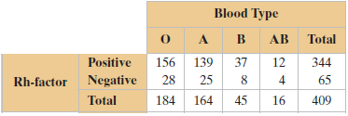
Using the Addition Rule
A blood bank catalogs the types of blood, including positive or negative Rh-factor, given by donors during the last five days. The number of donors who gave each blood type is shown in the table. A donor is selected at random.
1. Find the probability that the donor has type O or type A blood.
2. Find the probability that the donor has type B blood or is Rh-negative.

Slide 10
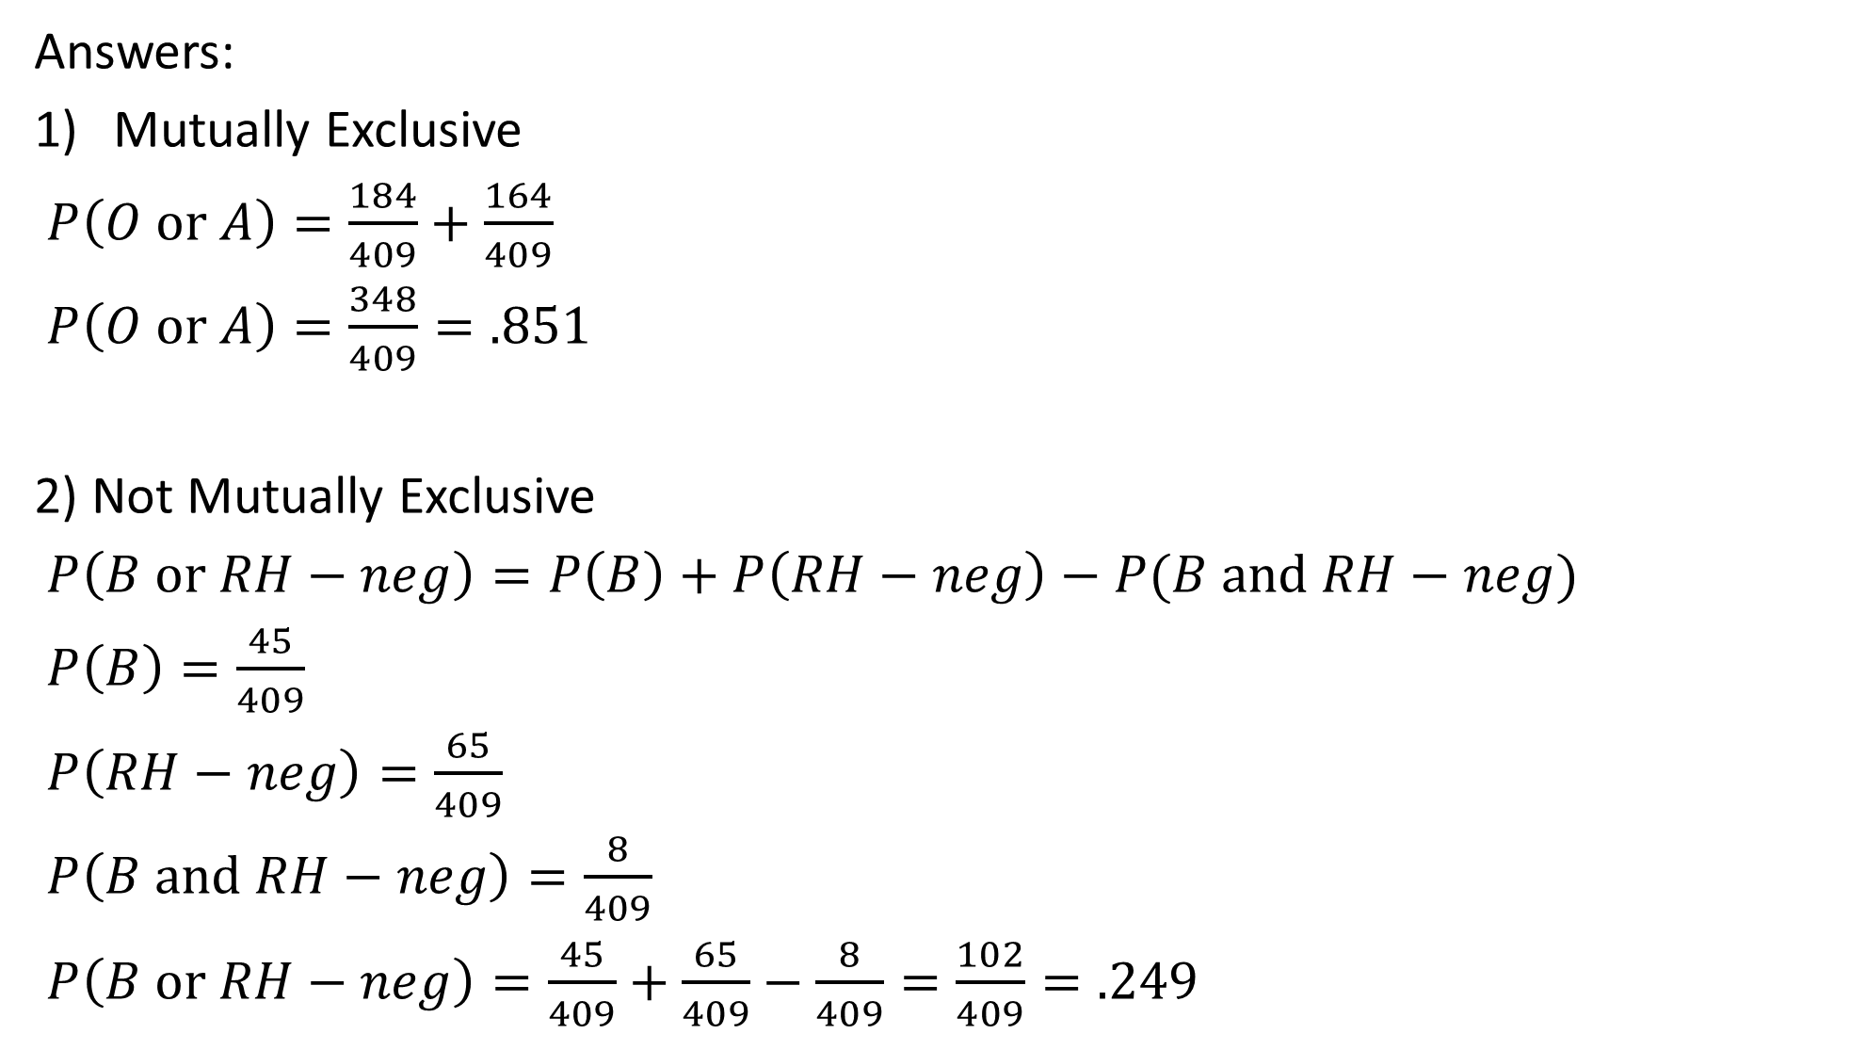
Answers:
Mutually Exclusive
$P\left(O or A\right)=\frac{184}{409}+\frac{164}{409}$
$P\left(O or A\right)=\frac{348}{409}=.851$
2) Not Mutually Exclusive
$P\left(B or RH−neg\right)=P\left(B\right)+P\left(RH−neg\right)−P(B and RH−neg)$
$P\left(B\right)=\frac{45}{409}$
$P\left(RH−neg\right)=\frac{65}{409}$
$P\left(B and RH−neg\right)=\frac{8}{409}$
$P\left(B or RH−neg\right)=\frac{45}{409}+\frac{65}{409}−\frac{8}{409}=\frac{102}{409}=.249$

Slide 12
Practice Problems
Pg. 161 # 1 – 7, 9 – 17 odd, 23, 25

