Slide 1
3.4 Additional Topics in Probability and Counting

Slide 2
Permutation
A permutation is an ordered arrangement of objects. The number of different permutations of n distinct objects is n!.
The expression $n!$ is read as factorial and is defined as follows. $n!=n∙\left(n−1\right)∙\left(n−2\right)∙\left(n−3\right)…3∙2∙1$
Special Case: $0!=1$
Why?
Because you can only have one group of zero objects, being the absence of a group.

Slide 3
Finding the Number of Permutations of n Objects
The objective of a $9×9$ Sudoku number puzzle is to fill the grid so that each row, each column, and each $3×3$ grid contain the digits 1 to 9. How many different ways can the first row of a blank $9×9$ Sudoku grid be filled?
Answer: $n!=9!=362,880$
The women’s hockey teams for the 2010 Olympics are Canada, Sweden, Switzerland, Slovakia, United States, Finland, Russia, and China. How many different final standings are possible?
Answer: $n!=8!=40,320$

Slide 4
Permutations of various sizes
The number of permutations of n distinct objects taken r at a time is $nPr=\frac{n!}{\left(n−r\right)!}$, where $r≤n$
How many distinct ways could grades be organized in class (assume you don’t know your grades)?
Answer: $n!$
How many distinct ways could the top three grades be organized (again, assume you don’t know your grades)?
Answer: $n=$ $r=$ $nPr=$

Slide 5
Finding $nPr$
Find the number of ways of forming four-digit codes in which no digit is repeated.
First, does the order matter?
Second, are you selecting a group of numbers at the same time?
Third, find $n and r$.
$n=10$and $r=4$
$10P4=\frac{10!}{\left(10−4\right)!}=\frac{10!}{6!}=5040$

Slide 6
Finding $nPr$
Forty-three race cars started the 2010 Daytona 500. How many ways can the cars finish first, second, and third?
First, does the order matter?
Second, are you selecting a group of numbers at the same time?
Third, find $n and r$.
$n=43$ and $r=3$
$43P3=\frac{43!}{\left(43−3\right)!}=\frac{43!}{40!}=74,046$

Slide 7
Distinguishable Permutations
The number of distinguishable permutations of n objects, where $n1$are of one type, $n2$are of another type, and so on, is $\frac{n!}{n1!∙n2!∙n3!…∙nk!}$ where $n1!+n2!+n3!+…+nk!=n$\
How many males and females are in the class?
How many distinguishable ways can your class be seated?
$n_{1}=$ number of girls, $n_{2}=$ number of boys, $n=$ the total number of students.

Slide 8
Finding the Number of Distinguishable Permutations
A building contractor is planning to develop a subdivision. The subdivision is to consist of 6 one-story houses, 4 two-story houses, and 2 split-level houses. In how many distinguishable ways can the houses be arranged?
Determine the total number: $6+4+2=12$
Determine the distinguishable types: 6 one-story houses, 4 two-story houses, and 2 split-level houses
$\frac{12!}{6!∙4!∙2!}=13,860$

Slide 9
Combinations of $n$ objects take $r$ at a time
A combination is a selection of r objects from a group of n objects without regard to order and is denoted by $nCr$. The number of combinations of r objects selected from a group of n objects is $nCr=\frac{n!}{\left(n−r\right)!r!}$
How many groups of 4 can be made in this class?

Slide 10
Finding the Number of Combinations
A state’s department of transportation plans to develop a new section of interstate highway and receives 16 bids for the project. The state plans to hire four of the bidding companies. How many different combinations of four companies can be selected from the 16 bidding companies?
First, does the order matter?
Determine $n$ and $r$
$n=16$ and $r=4$
$16C4=\frac{16!}{\left(16−4\right)!4!}=1820$

Slide 11
Finding the Number of Combinations
The manager of an accounting department wants to form a three-person advisory committee from the 20 employees in the department. In how many ways can the manager form this committee?
First, does the order matter?
Determine $n$ and $r$
$n=20$ and $r=3$
$20C3=\frac{20!}{\left(20−3\right)!3!}=1140$

Slide 12
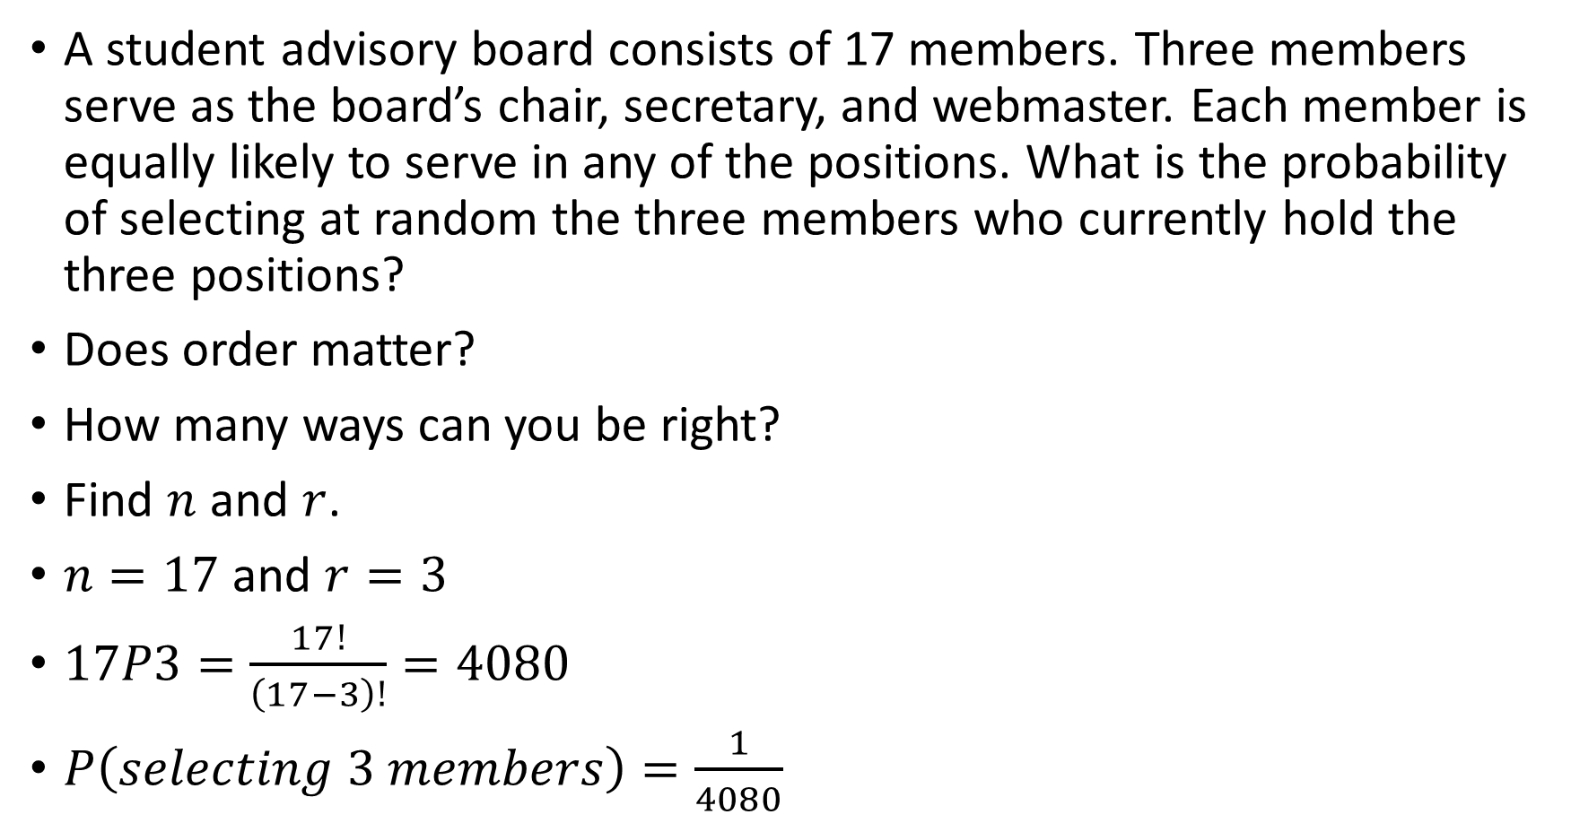
Finding Probabilities
A student advisory board consists of 17 members. Three members serve as the board’s chair, secretary, and webmaster. Each member is equally likely to serve in any of the positions. What is the probability of selecting at random the three members who currently hold the three positions?
Does order matter?
How many ways can you be right?
Find $n$ and $r$.
$n=17$ and $r=3$
$17P3=\frac{17!}{\left(17−3\right)!}=4080$
$P\left(selecting 3 members\right)=\frac{1}{4080}$

Slide 13
Finding Probabilities
You have 11 letters consisting of one M, four I’s, four S’s, and two P’s. If the letters are randomly arranged in order, what is the probability that the arrangement spells the word Mississippi?
It is a Distinguishable Permutation (different types of letters)
There is one favorable outcome
$\frac{11!}{1!∙4!∙4!∙2!}=34650$
$P\left(Mississippi\right)=\frac{1}{34650}$

Slide 14
Finding Probabilities
Find the probability of picking five diamonds from a standard deck of playing cards.
Since the order does not matter, you will be dealing with combinations.
How would you choose 5 diamonds out of the 13 diamonds available?
$13C5=\frac{13!}{\left(13−5\right)!∙5!}=1287$
How many combinations of 5 cards are there out of the 52 card deck?
$52C5=\frac{52!}{\left(52−5\right)!∙5!}=2,598,960$
$P\left(5 diamonds\right)=\frac{1287}{2,598,960}=.00005$

Slide 15
Practice Problems
Pg. 174 #2 – 26 even, 54, 56

