Slide 1
5.1 Intro to Normal Distributions and the Standard Normal Distribution
Read pages 236-238 and complete examples 1 and 2 “Try It Yourself”

Slide 2
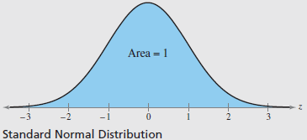
The Standard Normal Model
The standard normal distribution is a normal distribution with a mean of 0 and a standard deviation of 1.

Slide 3
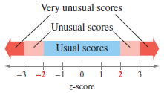
Z-Scores (Standardizing Values)
Z-scores standardize values so that we can compare results from two different data sets with different scales or units.
Z-scores tell us how many standard deviations a value is from the mean.
$z=\frac{\left(x−μ\right)}{σ}$

Slide 4
Finding z-scores
Find the z-score that corresponds to each value.
The weights of the contents of cereal boxes are normally distributed, with a mean weight of 12 ounces and a standard deviation of 0.05 ounce. The weights of the contents of four cereal boxes selected at random are 12.5 ounces and 11.92 ounces

Slide 5
Using the calculator to find the area under the normal curve
Find the z-score(s)
2nd VARS hit normalcdf (side note: we will not use normalpdf)
Black calculators: normalcdf(lower bound, upper bound) Yellow calculator: type the lower and upper in, leave the other information alone.
If they tell you to look for a number less than something: lower bound = -99, upper bound = z-score If they tell you to look for a number greater than something: lower bound = z-score, upper bound = 99 If the tell you between two numbers: lower bound = smaller z-score, upper bound = larger z-score

Slide 6
Finding the Area under the Standard Normal Curve
Find the area under the standard normal curve to the left of $z=−0.99$.
Answer: .161
Find the area under the standard normal curve to the right of $z=1.06$.
Answer: .145
Find the area under the standard normal curve between $z=−1.5$ and $z=1.25$
Answer: .828

Slide 7
Finding the area under the normal curve using a calculator.
What proportion of the cereal boxes are below 11.92 ounces ($z=−1.6)$?
Answer: .055
What proportion of the cereal boxes are above 12.16 ounces ($z=3.2)$?
Answer: $6.8×{10}^{−4}=.00068$
What proportion of the cereal boxes are between 11.92 and 12.16 ounces?
Answer: .945

Slide 8
Practice Problems
Pg. 244 # 19 – 37 odd, 43 – 44 (only part b), 50, 52, 56

