Slide 1
6.2 Confidence Intervals for the Mean (Small Samples)

Slide 2
The t-Distribution
When our sample is small, less than 30, the normal model cannot be used in the same way.
If the sample distribution is normally distributed we can use the t-distribution to approximate the population mean.
$t=\frac{\overline{x}−μ}{\frac{s}{\sqrt{n}}}$ (notice the similarity to the $z−$score formula)
Each t-distribution has certain degrees of freedom.
Area under the t-distribution curve is 1 or 100%
As the degrees of freedom increase, the t-distribution becomes closer to a normal model. After 30 d.f., the t-distribution is essentially a standard normal curve

Slide 3
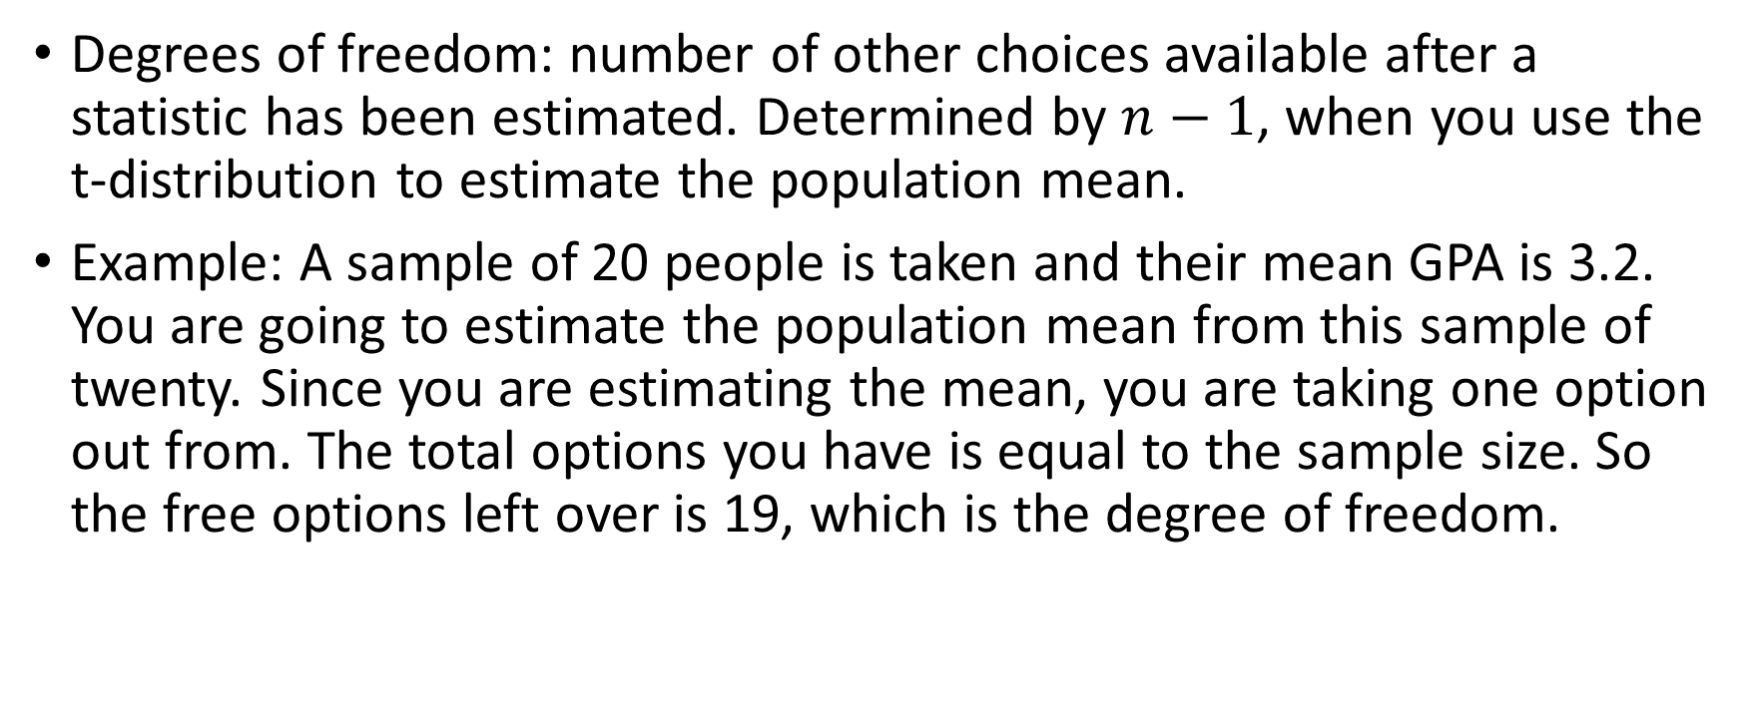
Degrees of Freedom
Degrees of freedom: number of other choices available after a statistic has been estimated. Determined by $n−1$, when you use the t-distribution to estimate the population mean.
Example: A sample of 20 people is taken and their mean GPA is 3.2. You are going to estimate the population mean from this sample of twenty. Since you are estimating the mean, you are taking one option out from. The total options you have is equal to the sample size. So the free options left over is 19, which is the degree of freedom.

Slide 4
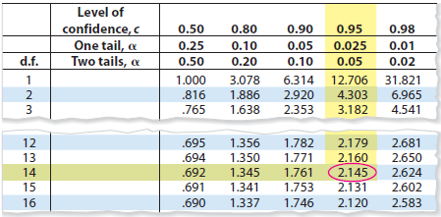
Example 1
Find the critical value for a 95% confidence level when the sample size is 15.
Start by finding the degrees of freedom
Use the table or technology to find the critical value
Table is on A18 in Appendix B in the back of the book

Slide 5
Example 2
Find the critical value for a 90% confidence level when the sample size is 22.

Slide 6
Creating a Confidence Interval for the Mean: t-Distribution
Find the $\overline{x}$ and $s$
Find d.f., confidence level, and critical value
Find the margin of error: $E=t_{c}\left(\frac{s}{\sqrt{n}}\right)$
Add and subtract the margin of error to the sample mean: $\overline{x}±E$

Slide 7
Example 3
You randomly select 16 coffee shops and measure the temperature of the coffee sold at each. The sample mean temperature is $162.0℉$ with a sample standard deviation of $10.0℉$. Construct a 95% confidence interval for the population mean temperature. Assume the temperatures are approximately normally distributed.
Using technology:
$Stat →Tests→Tinterval→enter stats$

Slide 8
Example 4
You randomly select 20 cars of the same model that were sold at a car dealership and determine the number of days each car sat on the dealership’s lot before it was sold. The sample mean is 9.75 days, with a sample standard deviation of 2.39 days. Construct a 99% confidence interval for the population mean number of days the car model sits on the dealership’s lot. Assume the days on the lot are normally distributed.

Slide 9
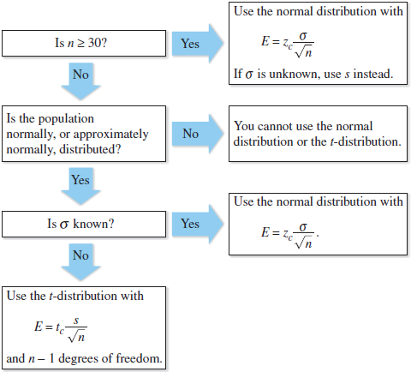
Is it a z-interval or a t-interval?
In words:
If the sample is 30 or more or the population standard deviation is known, use the z-interval.
If the sample is less than 30 and the population standard deviation is unknown, use the t-interval.

Slide 10
Example 5
You randomly select 25 newly constructed houses. The sample mean construction cost is $181,000 and the population standard deviation is $28,000. Assuming construction costs are normally distributed, should you use the normal distribution, the t-distribution, or neither to construct a 95% confidence interval for the population mean construction cost? Explain your reasoning and find the confidence interval.

Slide 11
Example 6
You randomly select 18 adult male athletes and measure the resting heart rate of each. The sample mean heart rate is 64 beats per minute, with a sample standard deviation of 2.5 beats per minute. Assuming the heart rates are normally distributed, should you use the normal distribution, the t-distribution, or neither to construct a 90% confidence interval for the population mean heart rate? Explain your reasoning and determine the confidence interval.

Slide 12
Practice Problems
Pg. 323 #1 – 7 odd, 13, 18, 20, 24, 26, 27, 28

